Slide 1




Data Science Capstone Project
Nina Haide
13.02.2025

Slide 2
Outline
Executive Summary
Introduction
Methodology
Results
Conclusion
Appendix

Slide 3

Executive Summary
Summary of Methodologies
Data Collection
Data Wrangling
Exploratory Data Analysis with Data Visualization
Exploratory Data Analysis with SQL
Building an Interactive Map with Folium
Building a Dashboard with Plotly Dash
Predictive Analysis (Classification)
Summary of all Results
Exploratory Data Analysis Results
Interactive Analysis Demo in Screenshots
Predictive Analysis Results

Slide 4

Introduction
SpaceX has emerged as the leading company of the commercial space age by making space travel more affordable. While their Falcon 9 rocket launches are advertised at $62 million, competitors charge upwards of $165 million per launch. The significant cost reduction is largely attributed to SpaceX's ability to reuse the first stage of their rockets.
By predicting whether the first stage will successfully land, we can estimate the cost of a launch. Using publicly available data and machine learning models, this project aims to forecast SpaceX's first stage reusability.
Key Research Questions:
1) What is the impact of variables like payload mass, launch site, number of flights, and orbital parameters on first stage landing success?
2) Has the success rate of landings improved over time?
3) Which binary classification algorithm is most effective for this prediction task?

Slide 5
Methodology
Data Collection:
- Using SpaceX Rest API
- Using Web Scrapping from Wikipedia
Data Wrangling:
- Filtering the data
- Dealing with missing values
- Using One Hot Encoding to prepare the data to a binary classification
Performed exploratory data analysis (EDA) using visualization and SQL
Performed Interactive Visual Analytics using Folium and Plotly Dash
Performed Predictive Analysis using Classification models
- Building, Fine-tuning and Evaluation of Classification models to achieve the best results

Slide 6

Data Collection
The Data collection process consists of a combination of API requests from SpaceX REST API and Web Scraping data from a table in SpaceX’s Wikipedia entry.
Data Columns obtained by using SpaceX REST API:
FlightNumber, Date, BoosterVersion, PayloadMass, Orbit, LaunchSite, Outcome, Flights, GridFins, Reused, Legs, LandingPad, Block, ReusedCount, Serial, Longitude, Latitude
Data Columns from Wikipedia Web Scraping:
Flight No., Launch Site, Payload, Payload Mass, Orbit, Customer, Launch Outcome, Version Booster, Booster Landing, Date, Time

Slide 7

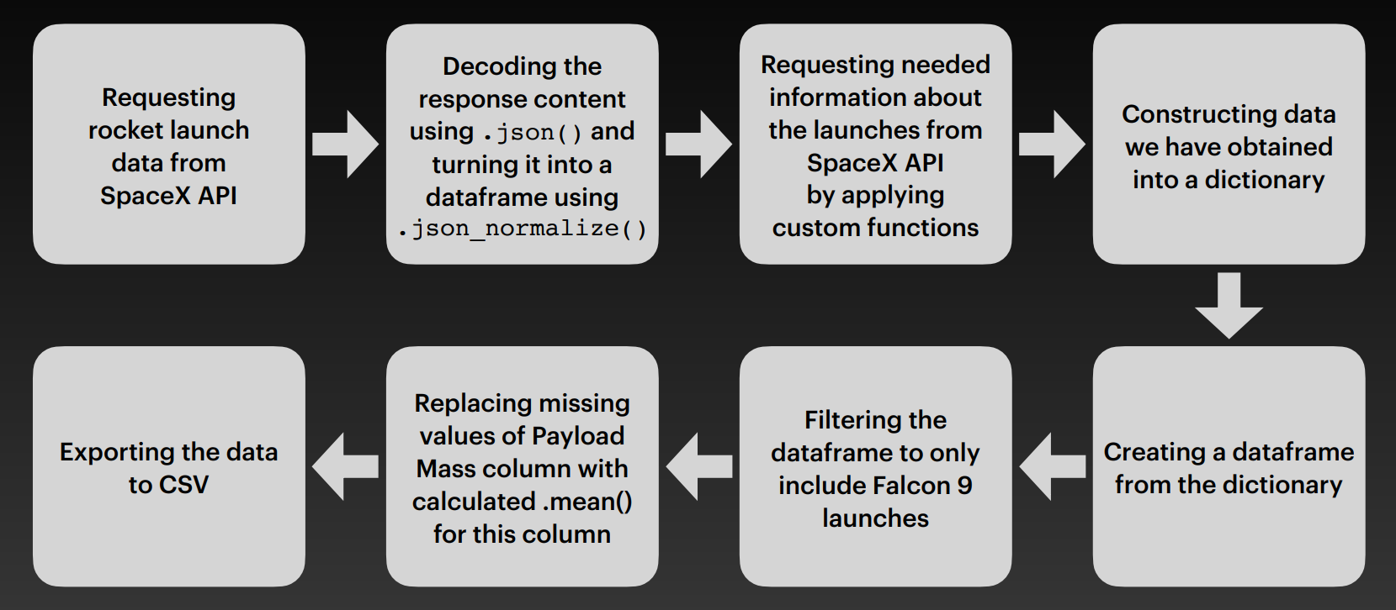
Data Collection – SpaceX API
GitHub Data Collection API

Slide 8
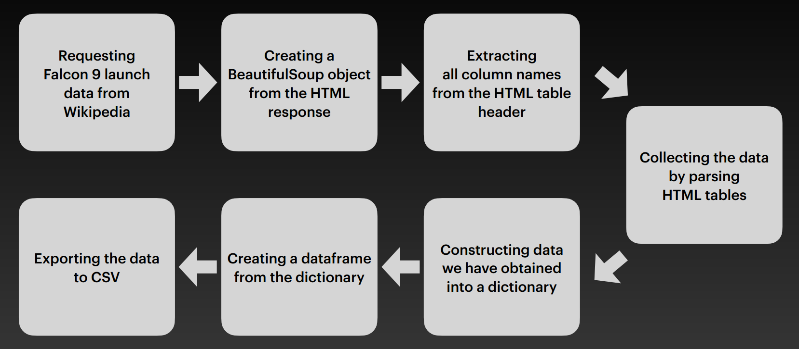
Data Collection –
Web Scraping
GitHub Web Scraping

Slide 9
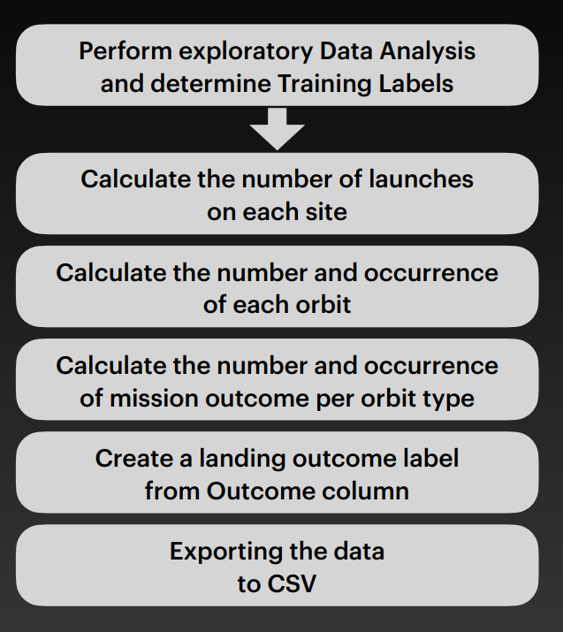
Data Wrangling
Landing Outcome Classifications
The dataset records various booster landing scenarios, which we've categorized into successful (1) and unsuccessful (0) outcomes:
Ocean Landings:
True Ocean: Successful landing in designated ocean zone
False Ocean: Failed landing attempt in designated ocean zone
Return to Launch Site (RTLS):
True RTLS: Successful landing at ground pad
False RTLS: Failed landing attempt at ground pad
Autonomous Spaceport Drone Ship (ASDS):
True ASDS: Successful landing on drone ship
False ASDS: Failed landing attempt on drone ship
For machine learning purposes, these outcomes were converted into binary labels:
1: Successful landing (True Ocean, True RTLS, or True ASDS)
0: Unsuccessful landing (False Ocean, False RTLS, or False ASDS)
GitHub Data Wrangling

Slide 10
EDA with SQL
Performed SQL queries:
• Displaying the names of the unique launch sites in the space mission
• Displaying 5 records where launch sites begin with the string ‘CCA'
• Displaying the total payload mass carried by boosters launched by NASA (CRS)
• Displaying average payload mass carried by booster version F9 v1.1
• Listing the date when the irst successful landing outcome in ground pad was achieved
• Listing the names of the boosters which have success in drone ship and have payload mass greater than 4000 but
less than 6000
• Listing the total number of successful and failure mission outcomes
• Listing the names of the booster versions which have carried the maximum payload mass
• Listing the failed landing outcomes in drone ship, their booster versions and launch site names for the months in
year 2015
• Ranking the count of landing outcomes (such as Failure (drone ship) or Success (ground pad)) between the date
2010-06-04 and 2017-03-20 in descending order
GitHub EDA with SQL

Slide 11

EDA with
Data Visualization
Several visualization types to explore relationships between launch variables were created:
Scatter Plots (showing variable relationships):
Flight Number versus Payload Mass
Flight Number versus Launch Site
Payload Mass versus Launch Site
Flight Number versus Orbit Type
Payload Mass versus Orbit Type
Bar Charts (comparing categorical data):
Orbit Type versus Success Rate
Line Charts (showing temporal trends):
Success Rate by Year
These visualizations serve two key purposes: identifying potential relationships between variables for machine learning model inputs and illustrating categorical comparisons and temporal trends in the data. Scatter plots reveal correlations, bar charts highlight categorical differences, and line charts demonstrate changes over time.
GitHub Data Visualization

Slide 12
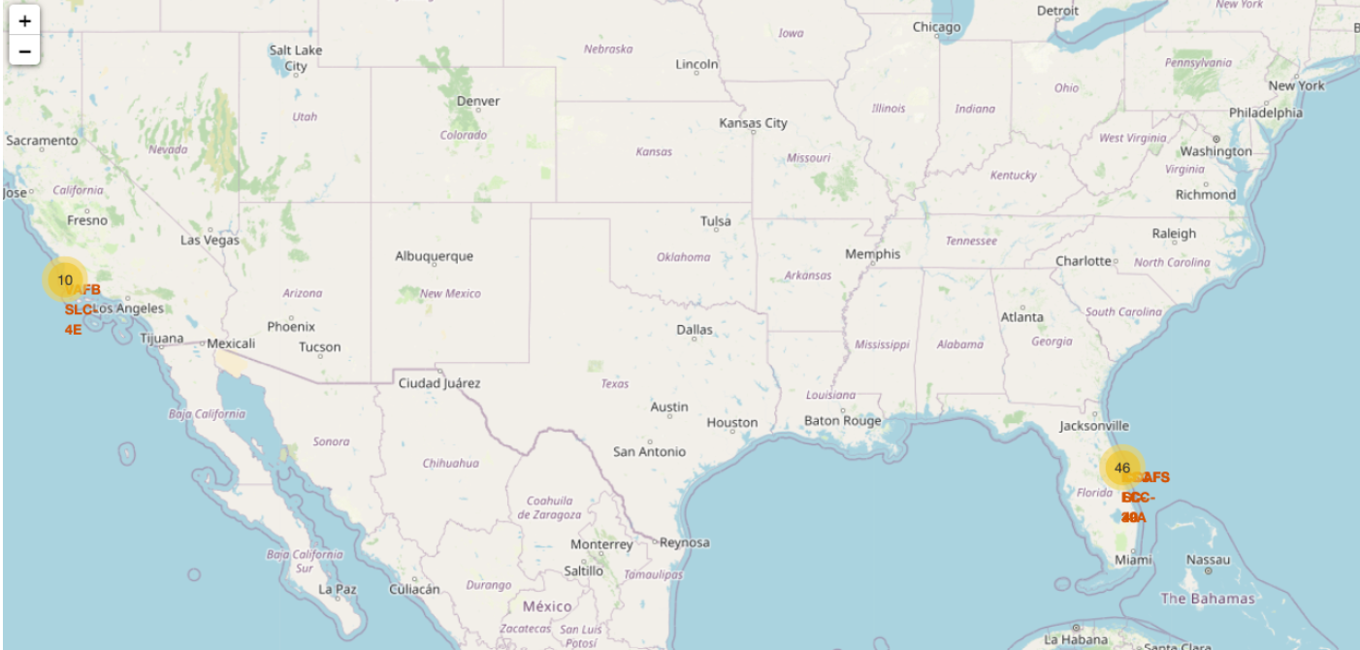
Build an Interactive Map with Folium
Markers of all Launch Sites:
Added Marker with Circle, Popup Label and Text Label of NASA Johnson Space Center using its latitude and longitude coordinates as a start location.
Added Markers with Circle, Popup Label and Text Label of all Launch Sites using their latitude and longitude coordinates to show their geographical locations and proximity to Equator and coasts.
Coloured Markers of the launch outcomes for each Launch Site:
Added coloured Markers of success (Green) and failed (Red) launches using Marker Cluster to identify which launch sites have relatively high success rates. Distances between a Launch Site to its proximities:
Added coloured Lines to show distances between the Launch Site KSC LC-39A (as an example) and its proximities like Railway, Highway, Coastline and Closest City
GitHub Interactive Map

Slide 13

Build a Dashboard with Plotly Dash
Launch Sites Dropdown List:
Added a dropdown list to enable Launch Site selection.
Pie Chart showing Success Launches (All Sites/Certain Site):
Added a pie chart to show the total successful launches count for all sites and the Success vs. Failed counts for the site, if a speciic Launch Site was selected.
Slider of Payload Mass Range:
Added a slider to select Payload range.
Scatter Chart of Payload Mass vs. Success Rate for the different Booster Versions:
- Added a scatter chart to show the correlation between Payload and Launch Success.
GitHub Plotly Dash

Slide 14
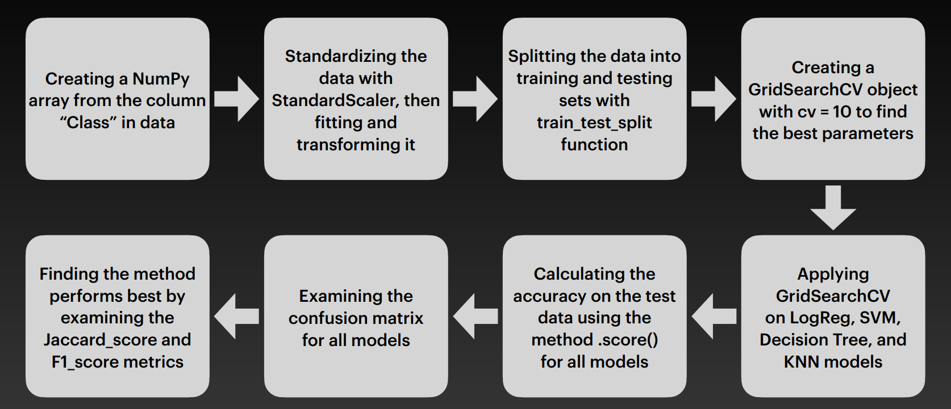
Predictive Analysis (Classification)
GitHub Prediction Analysis

Slide 15

Results
Exploratory data analysis results
Interactive analytics demo in screenshots
Predictive analysis results

Slide 16

Insights drawn from EDA

Slide 17

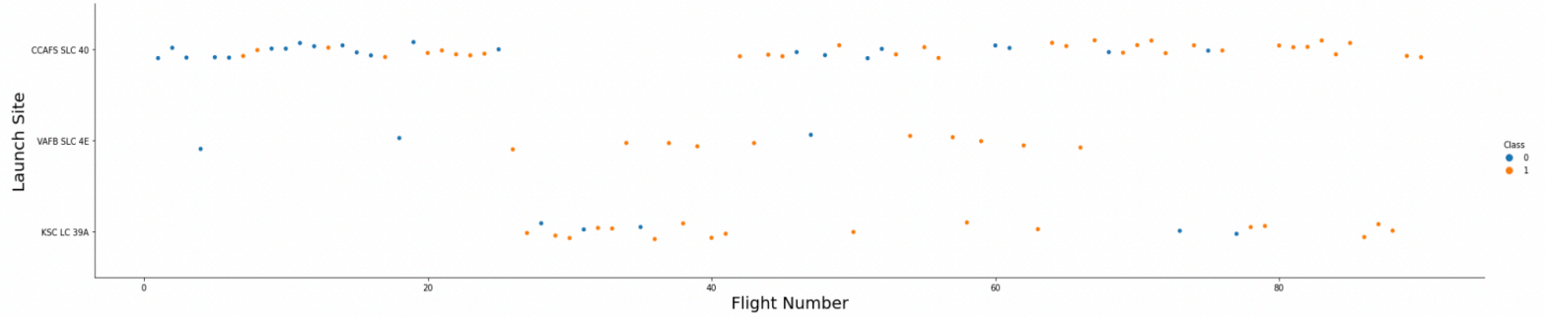
Flight Number vs. Launch Site
The earliest lights all failed while the latest lights all succeeded.
The CCAFS SLC 40 launch site has about a half of all launches.
VAFB SLC 4E and KSC LC 39A have higher success rates.
It can be concluded that each new launch has a higher rate of success.

Slide 18

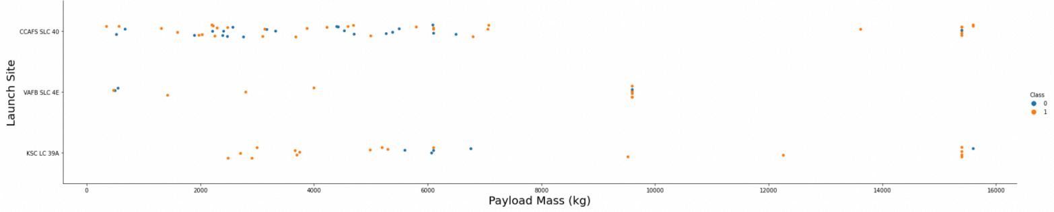
Payload vs. Launch Site
• For every launch site the higher the payload mass, the higher the success rate.
• Most of the launches with payload mass over 7000 kg were successful.
• KSC LC 39A has a 100% success rate for payload mass under 5500 kg too.

Slide 19
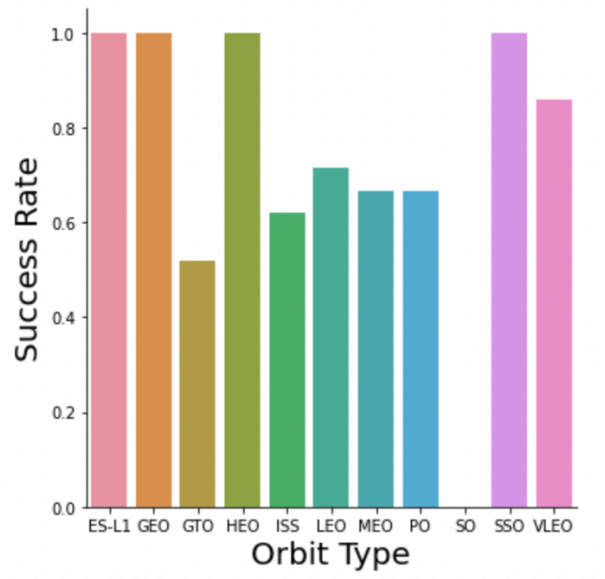
Success Rate vs. Orbit Type
• Orbits with 100% success rate: - ES-L1, GEO, HEO, SSO
• Orbits with 0% success rate: - SO
• Orbits with success rate between 50% and 85%: - GTO, ISS, LEO, MEO, PO

Slide 20
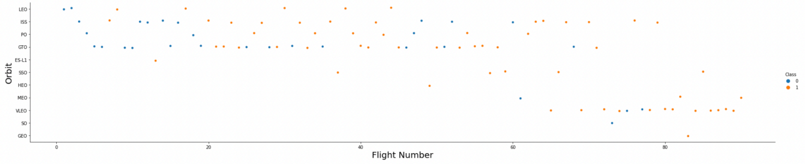
Flight Number vs. Orbit Type
In the LEO orbit the Success appears related to the number of lights - on the other hand, there seems to be no relationship between light number when in GTO orbit.

Slide 21
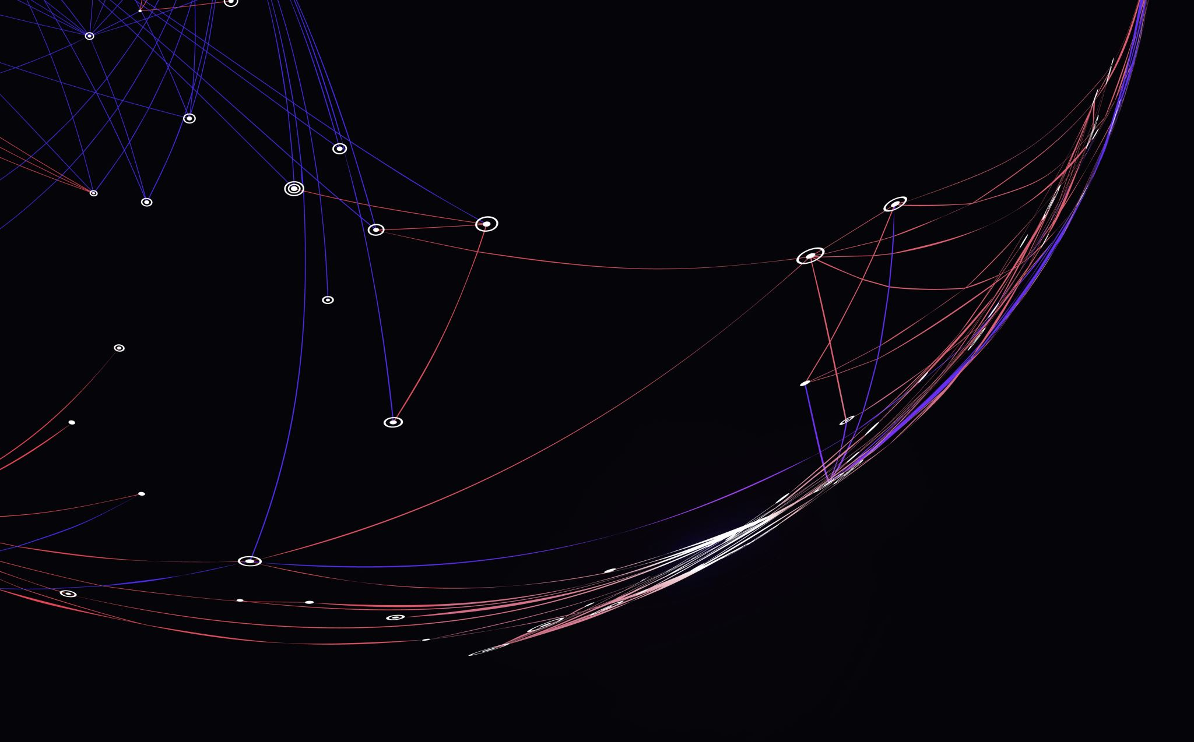
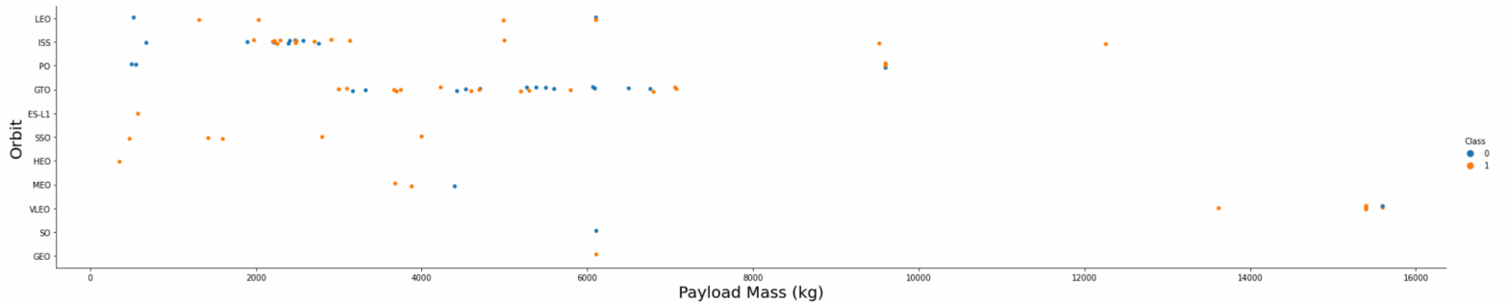
Payload vs. Orbit Type
Heavy payloads have a negative influence on GTO orbits and positive on GTO and Polar LEO (ISS) orbits.

Slide 22
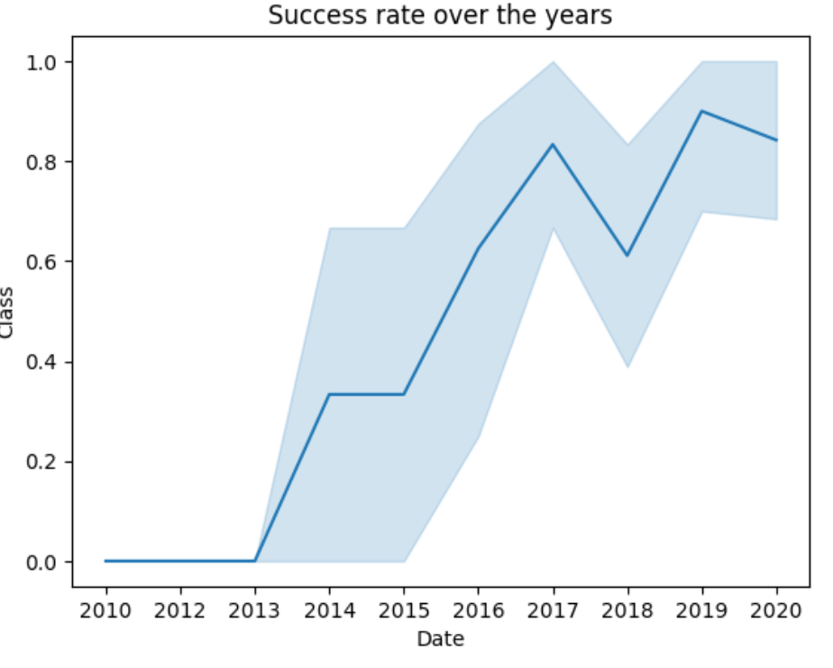
Launch Success Yearly Trend
From 2013 to 2020 the success rate continuously increased.

Slide 23
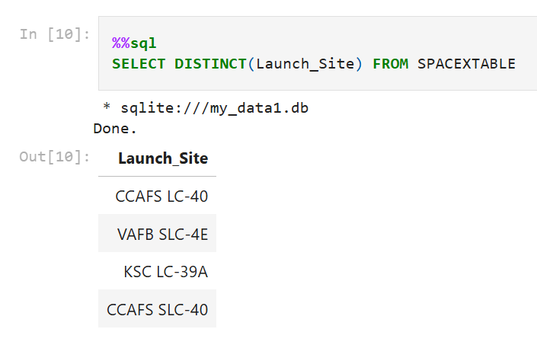
All Launch Site Names
Select query to find unique launch sites

Slide 24
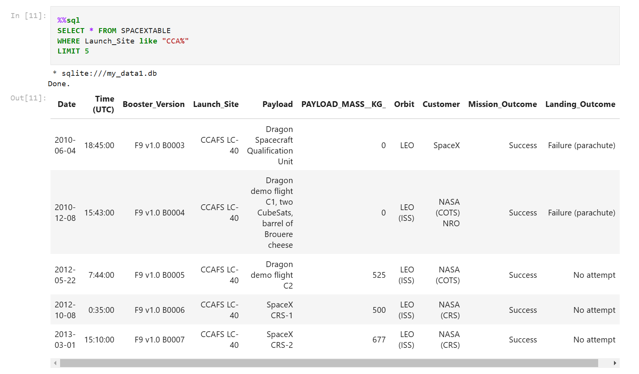
Launch Site Names Begin with 'CCA'
Select Query to find 5 records where launch sites begin with `CCA`, Limit serves to display a maximum of 5 lines

Slide 25
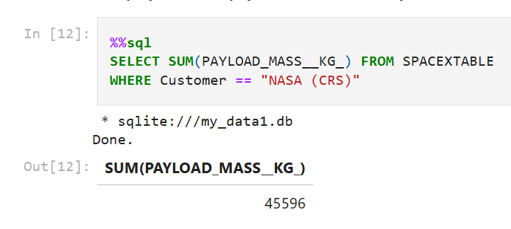
Total Payload Mass
Calculation of the total payload carried by boosters from NASA in kg

Slide 26
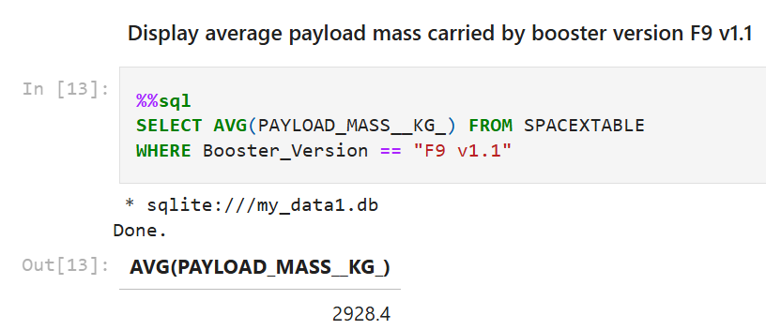
Average Payload Mass by F9 v1.1
Calculation of the average payload mass carried by booster version F9 v1.1 in kg

Slide 27
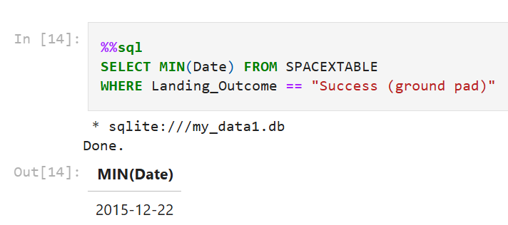
First Successful Ground Landing Date
Displaying the dates of the first successful landing outcome on ground pad with minimum function

Slide 28
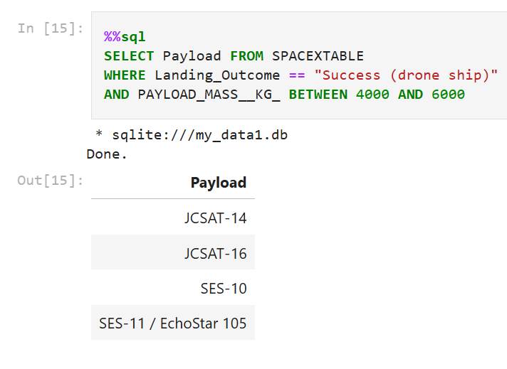
Successful Drone Ship Landing with Payload between 4000 and 6000
List with the names of boosters which have successfully landed on the drone ship and had a payload mass greater than 4000 but less than 6000 kg

Slide 29
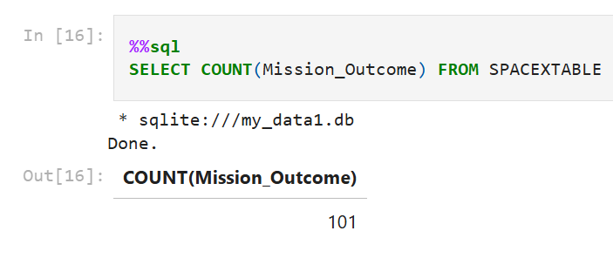
Total Number of Successful and Failure Mission Outcomes
Calculation of the total number of successful and failure mission outcomes

Slide 30
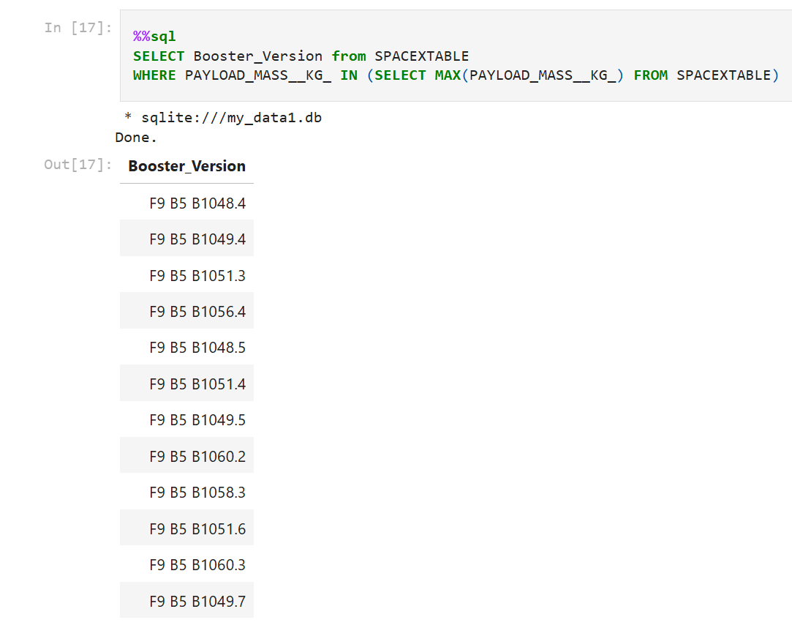
Boosters Carried Maximum Payload
List of the names of the booster which have carried the maximum payload mass in kg

Slide 31
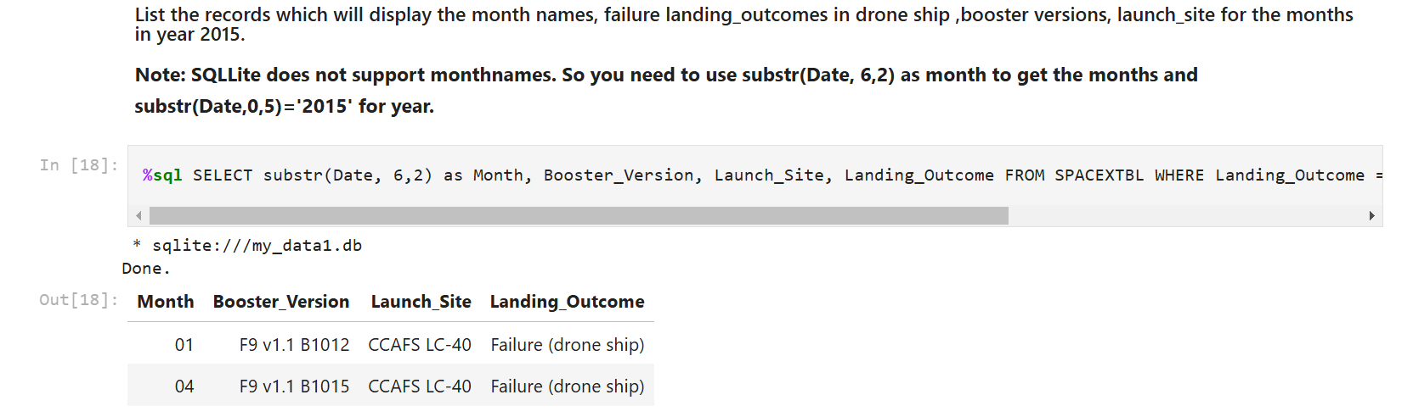
2015 Launch Records
List of the failed landing_outcomes in drone ship, their booster versions, and launch site names for in year 2015

Slide 32
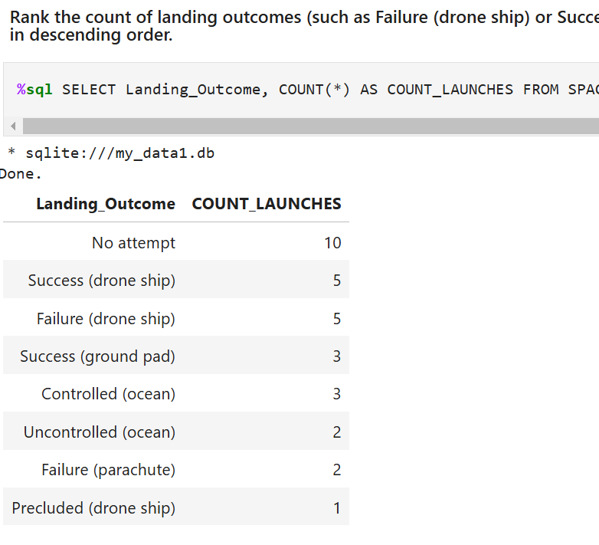
Rank Landing Outcomes Between 2010-06-04 and 2017-03-20
Ranking the count of landing outcomes (such as Failure (drone ship) or Success (ground pad)) between the date 2010-06-04 and 2017-03-20, in descending order

Slide 33
Launch Sites Proximities Analysis

Slide 34
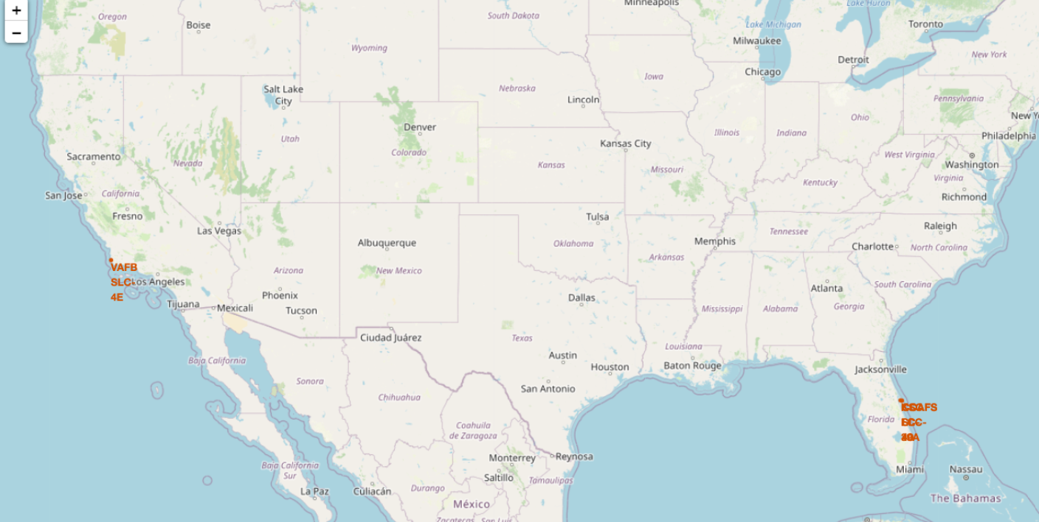
Interactive Folium Map
Display of the generated folium map with all launch sites’ location markers on a global map, close to the equator and the coast line for security reasons

Slide 35
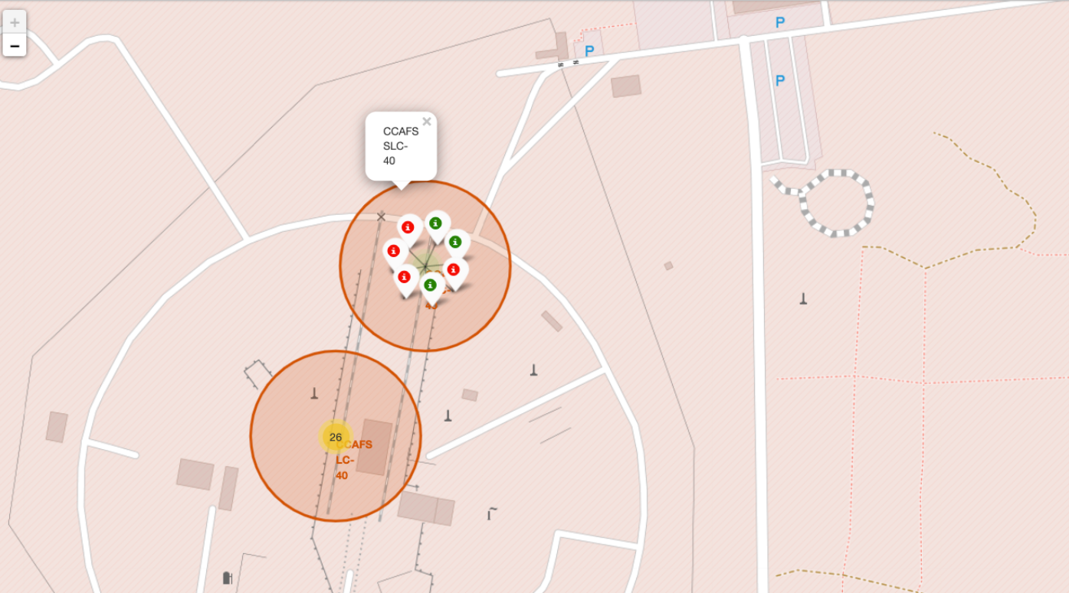
Colour-Labeled Markers
From the colour-labeled markers we should be able to easily identify which launch sites have relatively high success rates.
Green Marker = Successful Launch
Red Marker = Failed Launch
Launch Site KSC LC-39A has a very high Success Rate.

Slide 36

Distance from the launch sites
Failed rockets with its high speed can cover distances like 15-20 km in few seconds. It could be potentially dangerous to populated areas.

Slide 37
Build a Dashboard with Plotly Dash

Slide 38
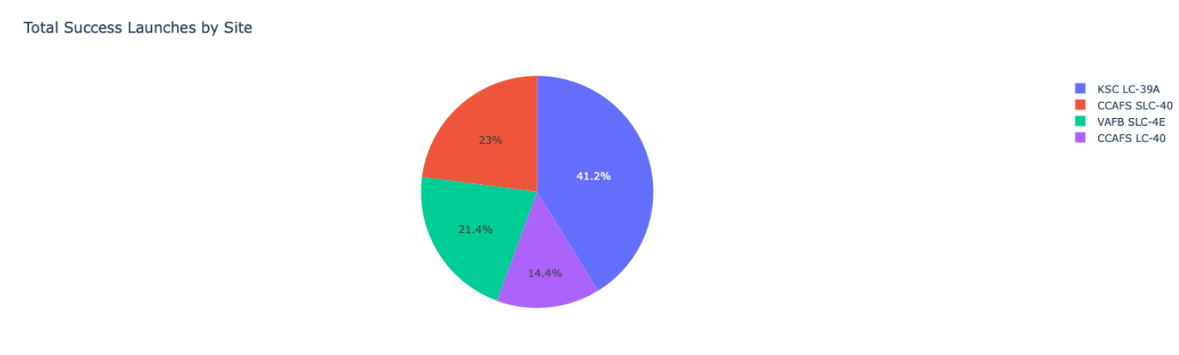
Launch Success
The chart clearly shows that from all the sites, KSC LC-39A has the most successful launches.

Slide 39
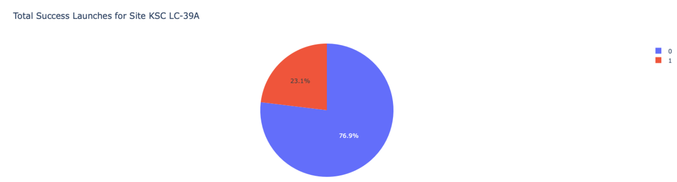
Highest Launch Success Ratio
KSC LC-39A has the highest launch success rate (76.9%) with 10 successful and only 3 failed landings.

Slide 40
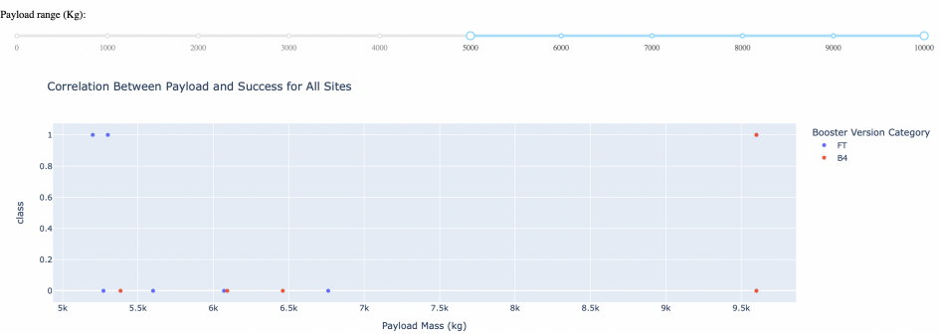
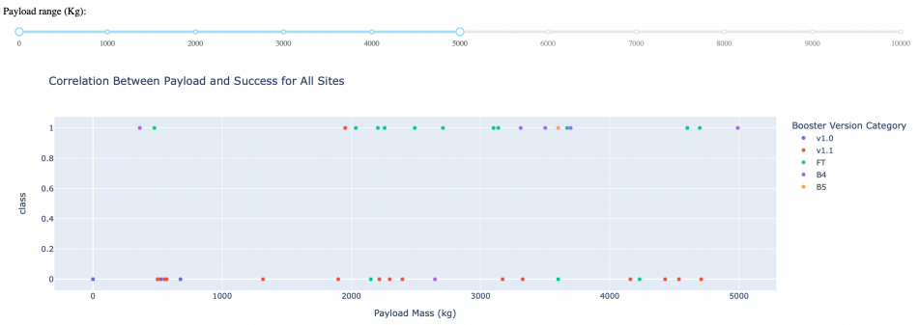
Payload Mass vs. Launch Outcome for all sites
The charts show that payloads between 2000 and 5500 kg have the highest success rate.

Slide 41
Predictive Analysis (Classification)

Slide 42
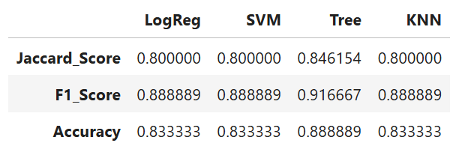
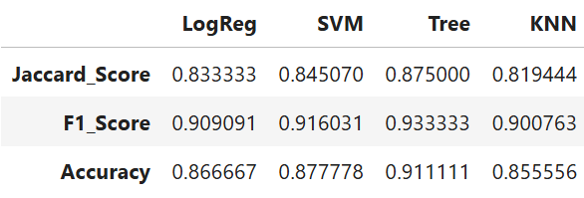
Classification Accuracy
Scores and Accuracy of the Test Set
Based on the scores of the Test Set, we can not confirm which method performs best.
Same Test Set scores may be due to the small test sample size (18 samples). Therefore, we tested all methods based on the whole Dataset.
The scores of the whole Dataset confirm that the best model is the Decision Tree Model. This model has not only higher scores, but also the highest accuracy.
Scores and Accuracy of the entire Data Set

Slide 43
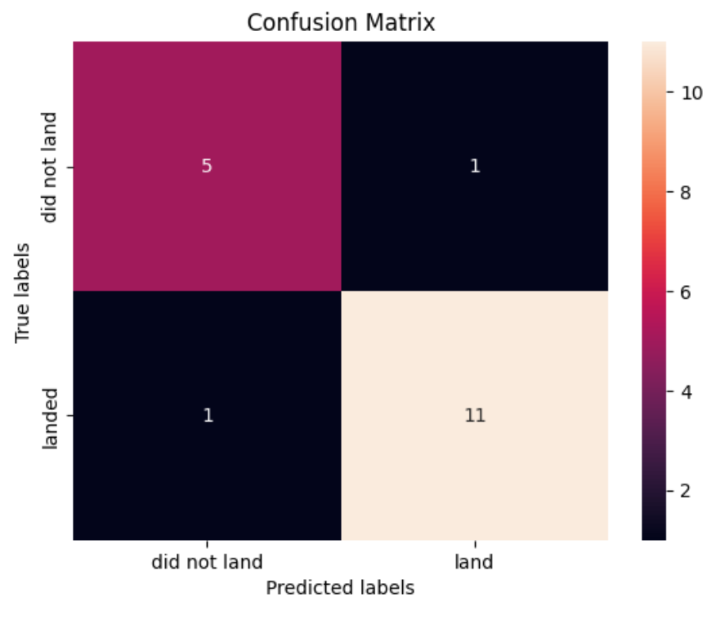
Confusion Matrix
When examining the confusion matrix, we see that logistic regression can distinguish between the different classes, the major problem is false positives.

Slide 44
Decision Tree algorithm demonstrates superior performance for this dataset
Lower payload mass correlates with higher landing success rates
Launch sites are strategically positioned:
Near the equator for orbital velocity advantage
Along coastlines for safety considerations
Landing success rates show consistent improvement over time
Kennedy Space Center's Launch Complex 39A (KSC LC-39A) achieves the highest success rate among all launch sites
Perfect (100%) landing success rate achieved for specific orbits:
Earth-Sun Lagrange Point 1 (ES-L1)
Geostationary Earth Orbit (GEO)
Highly Elliptical Orbit (HEO)
Sun-Synchronous Orbit (SSO)
Conclusion

Slide 45
Thank You!

